Slide 1
Chapter 7
Computer Networks and Cloud Computing

Slide 2
Learning Objectives (1 of 2)
Describe and compare different network technologies, including dial-up, broadband, and wireless
Explain how different kinds of networks (LAN, WLAN, WAN) are connected, and how communication works in each
Explain the importance of standards and protocols for communication among computing devices

Slide 3
Learning Objectives (2 of 2)
Name the layers of the network protocol hierarchy, and describe the purpose of each layer
Name four services that computer networks provide and explain their social impact
Explain cloud computing and discuss its potential benefits
Describe the highlights of the history of the Internet and the web

Slide 4
Introduction
Computer networks have had revolutionary impact
Education, research, medicine, and more benefits
Worldwide communications
Spread of information and data
Possibly a vehicle for spreading misinformation
Fake news
Rumors
Falsehoods
Helps to equalize access to information

Slide 5
Basic Networking Concepts (1 of 22)
Computer network is made up of computing devices, nodes, and interconnections
Networks may be wired or wireless; communication links use various technology
Wired networks
Dial-up
Broadband (cable modems and DSL)
Wireless networks
WLAN, WWAN, MAN, LAN, PAN

Slide 6
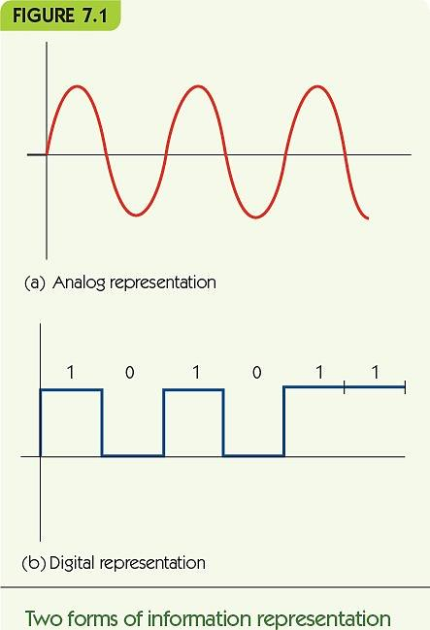
Basic Networking Concepts (2 of 22)
Switched, dial-up telephone lines
Analog lines
Transmit digital data
Modem modulates carrier wave
Speeds up to 56 Kbps
Bandwidth = capacity

Slide 7
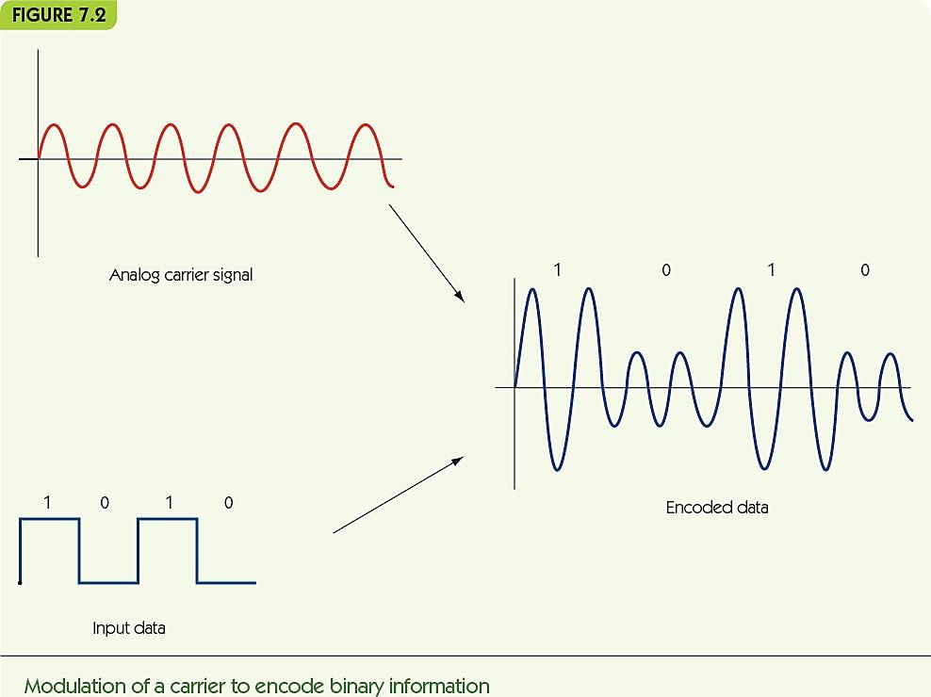
Basic Networking Concepts (3 of 22)

Slide 8
Basic Networking Concepts (4 of 22)
Broadband provides transmission rate ≥ 25 Mbps
Home Internet connections
Asymmetric download/upload speeds
Digital subscriber line (DSL)
Uses phone lines but sends digital signal on different frequencies than voice
Download rate: 5–50 Mbps; upload rate: 1–5 Mbps
Cable modem
Uses cable TV lines
Data rates up to ≈100 Mbps download, with upload speeds averaging between 3 and 5 Mbps

Slide 9
Basic Networking Concepts (5 of 22)
Commercial/institutional Internet connections
Ethernet (1970s)
Dedicated coaxial cable
Operates at 10 Mbps
Fast Ethernet (early 1990s)
Dedicated lines (coaxial, fiber-optic, or twisted-pair copper wire)
Operates at 100 Mbps
Gigabit Ethernet Standard (late 1990s)
From gigabit networking research project
IEEE standard
Operates at 1000 Mbps

Slide 10
Basic Networking Concepts (6 of 22)
FIGURE 7.3
Line Type | Speed | Time to Transmit 8 Million Bits (One Compressed Image)
Dial-up phone line | 56Kbps | 2.4 minutes
DSL line, cable modem | 2Mbps | 4 seconds
Ethernet | 10 Mbps | 0.8 second
Fast Ethernet | 100 Mbps | 0.08 second
Gigabit Ethernet | 1 Gbps | 0.008 second
10-gigabit Ethernet | 10 Gbps | 0.0008 second
100-gigabit Ethernet | 100 Gbps | 0.00008 second
Transmission time of an image at different transmission speeds

Slide 11
Basic Networking Concepts (7 of 22)
Wireless data communication
Allows network communication without the need for cables holding you to one place.
Radio, microwave, or infrared signals to mobile computers
Mobile computing delivers data regardless of location
Bluetooth
Low power, close range (30–50 feet), connects devices like wireless mice, cameras, video games

Slide 12
Basic Networking Concepts (8 of 22)
Wireless local area network (WLAN)
Computers transmit wirelessly to a base station which has a wired connection
Range of 150–300 feet
Terminology
Wi-Fi: standard term for wireless network communication
IEEE 802.11 wireless network standard
Wi-Fi hot spot: library, campus, coffee shop, etc.
Metropolitan Area Network (MAN): A built-out wireless network that covers blocks or cities

Slide 13
Basic Networking Concepts (9 of 22)
Wireless wide area network (WWAN)
Computers transmit wirelessly to a remote base station which has a wired connection
Cellular technology involves antennas on towers miles apart
Example: 4G
Voice and data; transmits at 50–500 Mbps
Signal may be blocked when indoors
Errors with data transmission can slow performance
Security concern: wireless signals are easy to intercept

Slide 14
Basic Networking Concepts (10 of 22)
Local area networks (LAN)
Wired connection
Computers, printers, and servers are in close proximity
Examples: same room, office building, or campus
Privately owned and operated
Topology: how computers are connected
Affects how they communicate
Can be made up of different types of systems and OS installs (Mac, Linux, Windows, or Android)

Slide 15
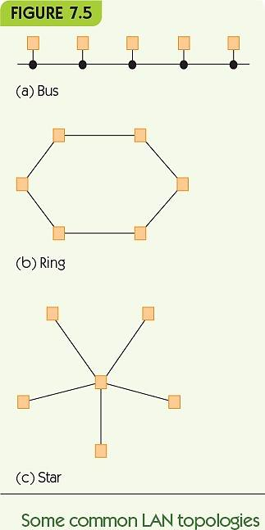
Basic Networking Concepts (11 of 22)
Bus topology
Shared lines
Devices take turns using the line
Ring topology
Messages circulate until they reach the source
Star topology
All messages are sent to a central node, which routes messages to their destinations

Slide 16
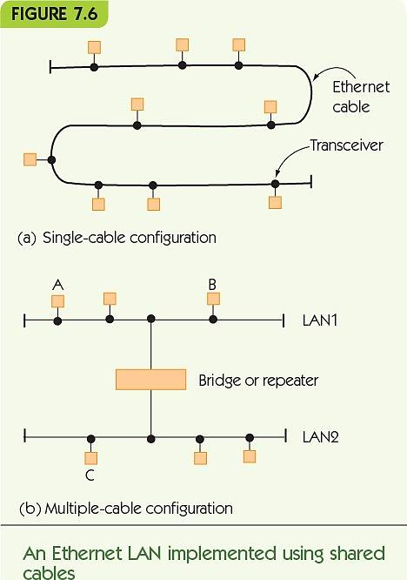
Basic Networking Concepts (12 of 22)
Ethernet LAN with shared cable
Bus topology
Single cable over short distances
Multiple cables over longer distances
Repeater amplifies the signal
Bridge routes messages only when necessary

Slide 17
Basic Networking Concepts (13 of 22)
Ethernet LAN with switch
Bus topology, still
Shared cable is inside the switch
Wiring closet contains switch and ports
Ethernet jacks in rooms connect to the switch in the closet
Wireless base stations also connect to the switch in the closet

Slide 18
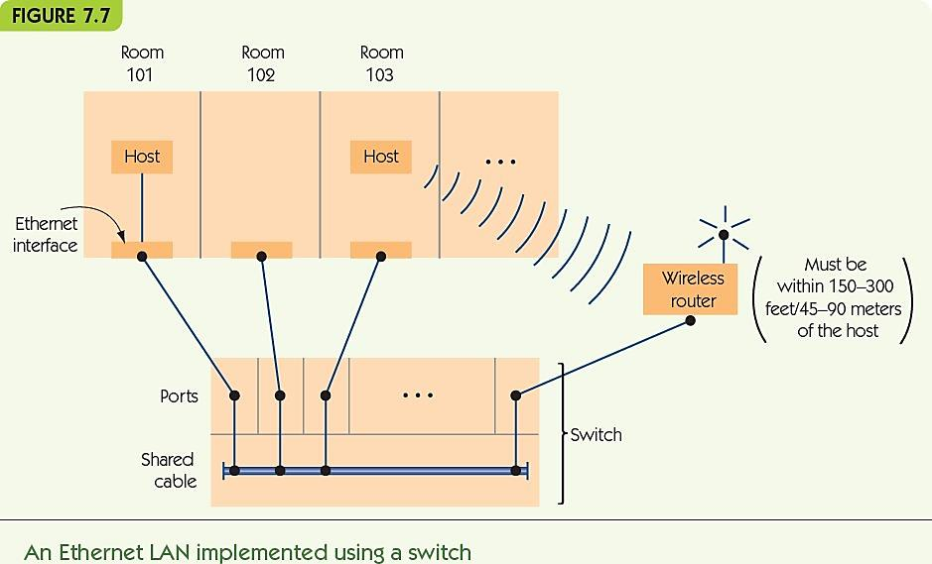
Basic Networking Concepts (14 of 22)

Slide 19
Basic Networking Concepts (15 of 22)
Wide area networks (WANs)
Wired connection
Connected computers, located at great distances
Examples: across state, country, or world
Dedicated point-to-point lines
Computers connect to other computers on individual lines
Store-and-forward, packet-switched
Packets go from node to node until reaching their destination

Slide 20
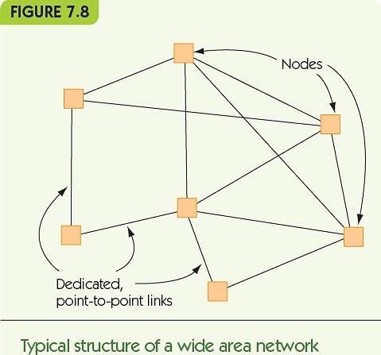
Basic Networking Concepts (16 of 22)

Slide 21
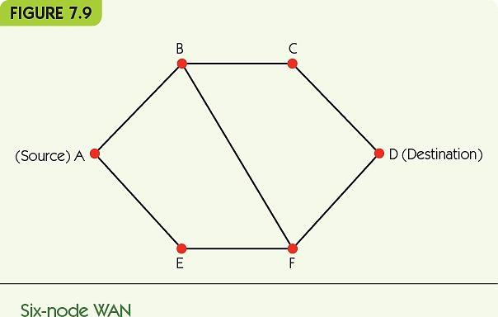
Basic Networking Concepts (17 of 22)
Routing of packets is determined dynamically
A-B-C-D or A-B-F-D or A-E-F-D or A-E-F-B-C-D
Redundant paths, fault tolerance, responsive to traffic load

Slide 22
Basic Networking Concepts (18 of 22)
Overall Structure of the Internet
Combination of LANs and WANs
Connected by routers that direct message traffic
Internet service provider (ISP) provides access to the Internet for private individuals and organizations
Domain Name Services (DNS) provide addressing information
ISPs exist at multiple levels: local, regional, national, and international (tier-1 network)

Slide 23
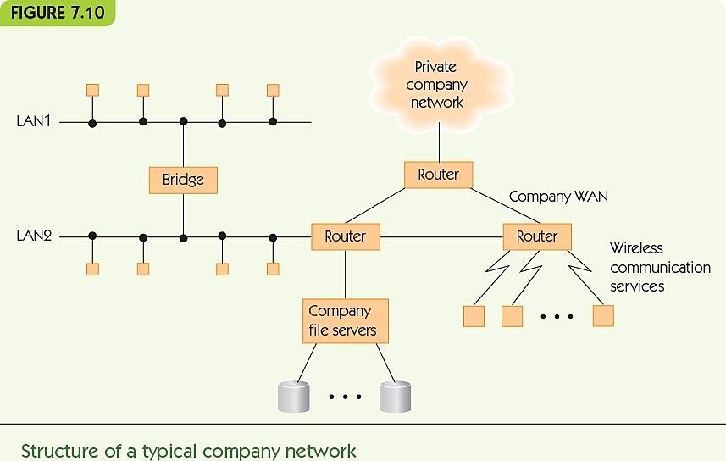
Basic Networking Concepts (19 of 22)

Slide 24
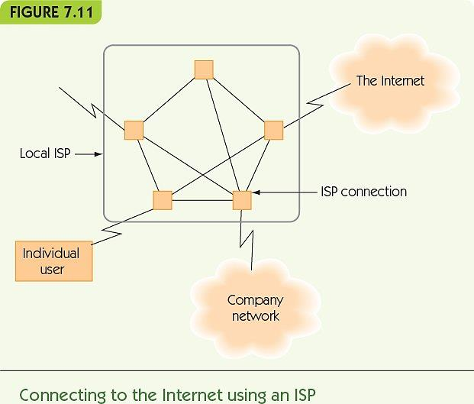
Basic Networking Concepts (20 of 22)

Slide 25
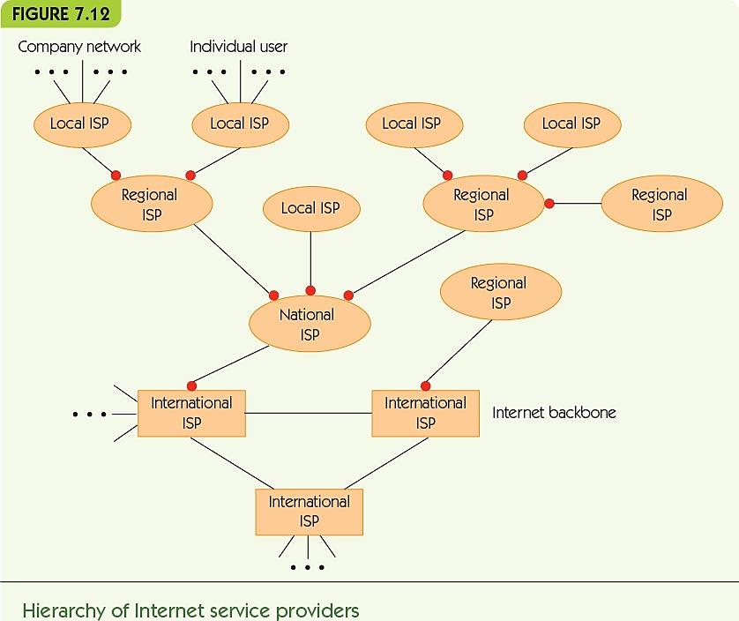
Basic Networking Concepts (21 of 22)

Slide 26
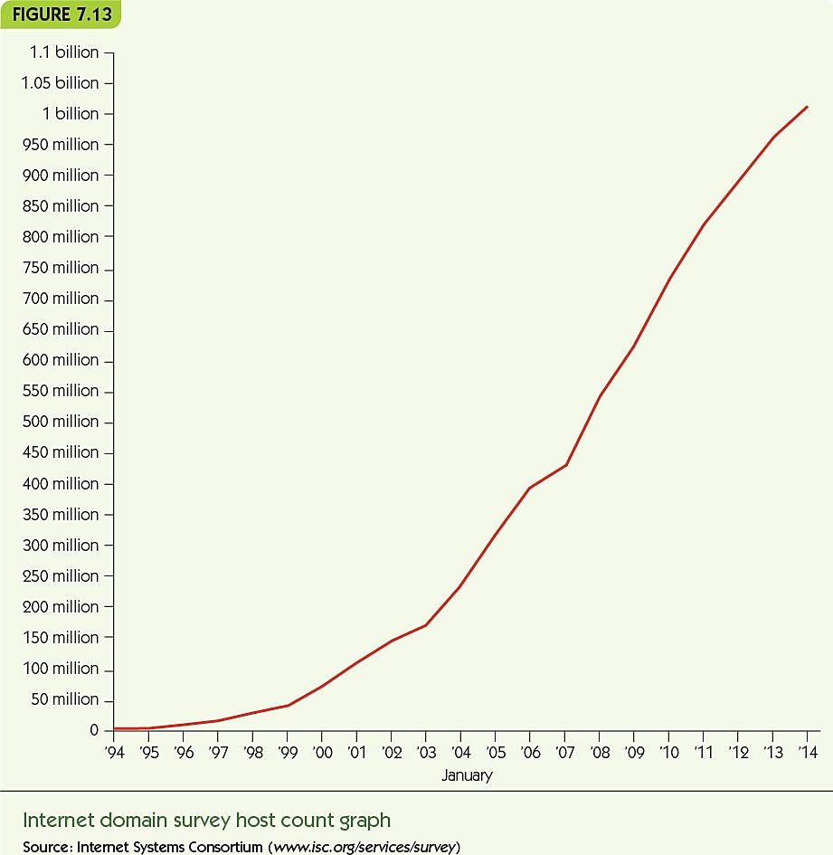
Basic Networking Concepts (22 of 22)
The rate at which domain survey hosts has grown in just over two decades is astonishing.

Slide 27
Communication Protocols (1 of 2)
Protocol: a standard set of rules for communicating
Protocol hierarchy/protocol stack, TCP/IP
Layers of protocols
Physical transmission to end application rules and standards
Internet Society makes standards and promotes research
Standards evolve over time
International agreements make Internet possible

Slide 28
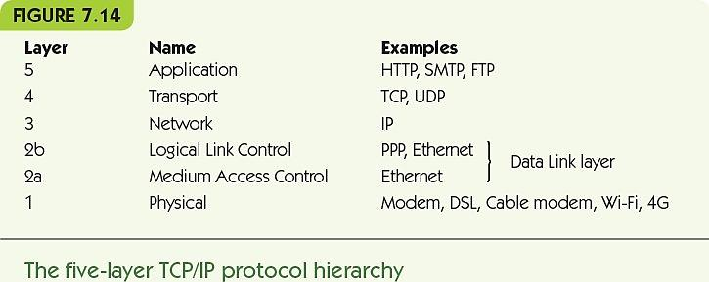
Communication Protocols (2 of 2)

Slide 29
Communication Protocols: Physical Layer (1 of 2)
Physical layer protocols
Rules for exchanging binary data across a physical channel (fiber-optic, twisted-pair, wireless, etc.)
How to know when a bit is present on the line
How much time the bit will remain on the line
Whether the bit is digital or analog in form
What physical quantities represent 0 and 1
Shape of the connector between the computer and the transmission line
Create an abstract “bit pipe” used by higher layers

Slide 30
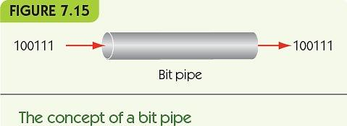
Communication Protocols: Physical Layer (2 of 2)

Slide 31
Communication Protocols: Data Link Layer (1 of 6)
Data Link protocols
Ensure reliable transmission of bits
Error detection and correction notice failures in the transmission and fix them
Framing determines which bits belong to one message
Two parts
Layer 2a: Medium Access Control
Layer 2b: Logical Link Control

Slide 32
Communication Protocols: Data Link Layer (2 of 6)
Medium Access Control protocols
Rules for communicating on shared lines – who has ownership
Contention-based protocol
When a node wants to send a message
Listen to the line and wait until it is free
Begin transmitting as soon as it is free
If a collision results, wait a random amount of time
Repeat
Advantage: distributed, no master bottleneck

Slide 33
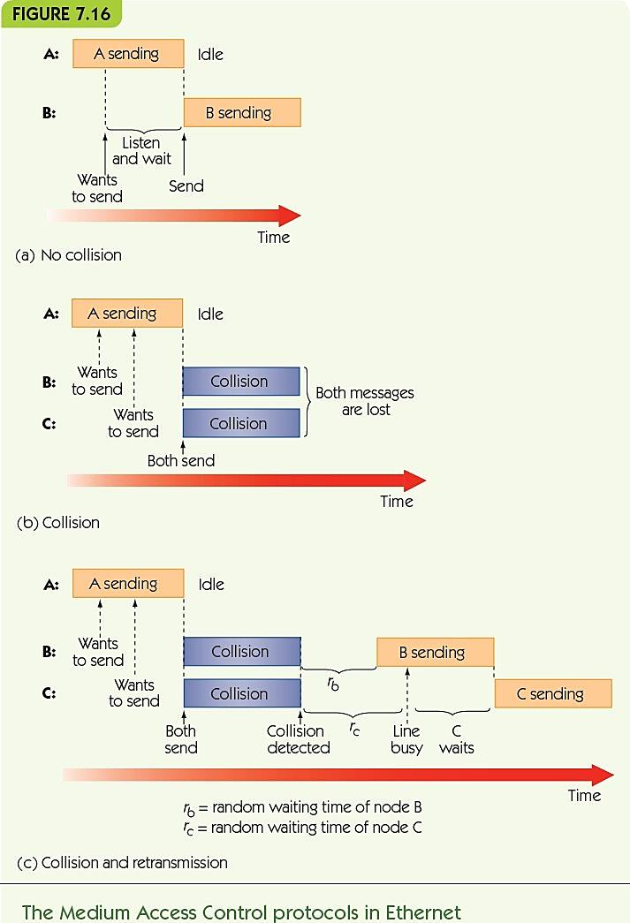
Figure 7.16 The Medium Access Control protocols in Ethernet

Slide 34
Communication Protocols: Data Link Layer (3 of 6)
Logical Link Control protocols
Rules for detecting and correcting errors
ARQ algorithm (automatic repeat request)
Sender
Transmit a packet and wait for ACK or time out
If ACK received, go on to next packet
Otherwise, repeat on the current packet
Receiver
If no error, return acknowledgement message (ACK)
Otherwise, return nothing

Slide 35
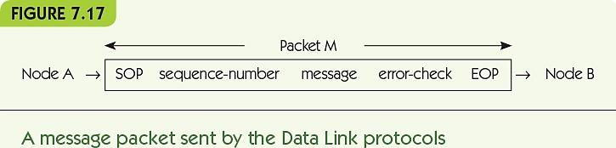
Communication Protocols: Data Link Layer (4 of 6)
Packet contains:
Markers for start and end of packet (SOP and EOP)
Sequence number for packet (e.g., 2 of 5)
Packet data
Error-checking bits

Slide 36
Communication Protocols: Data Link Layer (5 of 6)
Purpose of the Data Link layer
Create a virtual error-free message pipe
Messages go in one end
Come out the other correct and in the right order

Slide 37
Communication Protocols: Network Layer (1 of 3)
Network layer protocols
Transmit messages across multiple nodes in a network
Good faith transmission model
Requirements
Standard for addressing all network nodes
Routing method for finding a route from any node to any other node
Internet network layer: IP (Internet Protocol)

Slide 38
Communication Protocols: Network Layer (2 of 3)
Addressing
Host name: human-friendly name for node
IP address: unique numerical address used by the computer, 141.140.1.5
Domain Name Service (DNS): maps host names to IP addresses
Symbolic host name goes to a local DNS server
If it has no record, goes to remote servers until one has the host name and retrieves the IP address

Slide 39
Communication Protocols: Network Layer (3 of 3)
Routing
Picking a path through the network from source to destination
Seeks the shortest/best path: fastest travel
Massive network requires efficient path-seeking
Networks are dynamic: nodes come online and go offline all the time—routing must adapt quickly

Slide 40
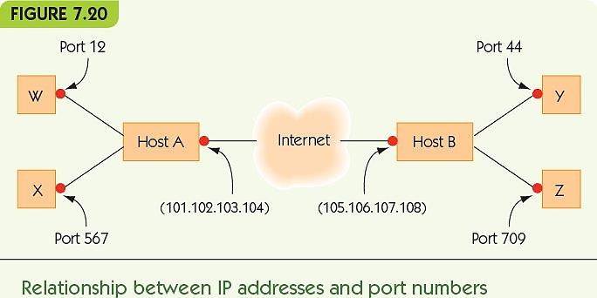
Communication Protocols: Transport Layer (1 of 3)
Transport layer protocols
Application-to-application, reliable packet delivery
Port number: unique identifier for a program

Slide 41
Communication Protocols: Transport Layer (2 of 3)
Application types have standard port numbers
Web server ► port 80
Domain Name Service ► port 42
SMTP, sending email ► port 25
TCP (Transport Control Protocol)
Ensures no errors
Establishes ordered delivery of packets
Another version of ARQ algorithm
Virtual direct, quality connection between programs

Slide 42
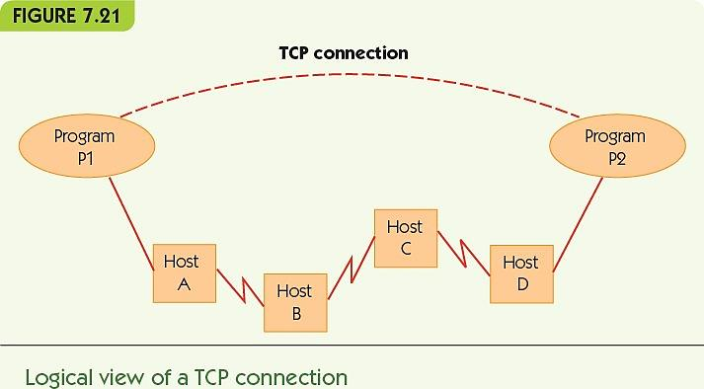
Communication Protocols: Transport Layer (3 of 3)

Slide 43
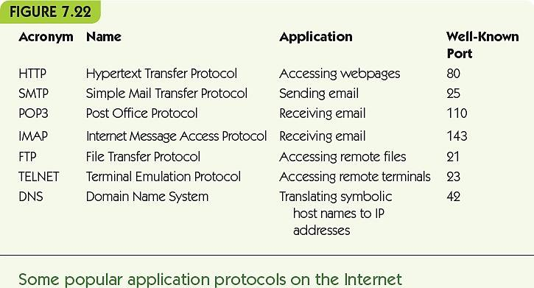
Communication Protocols: Application Layer (1 of 3)
Application layer protocols
Handle formatted data transmitted between application programs

Slide 44
Communication Protocols: Application Layer (2 of 3)
Hypertext Transfer Protocol (HTTP)
Web page/service is identified by a unique URL (Uniform Resource Locator)
protocol://host name/page
Multiple protocols: http, mailto, news, ftp
Web browser uses TCP to send formatted messages to a web server, and vice versa
TCP uses Network layer (IP), Data Link layer, and Physical layer

Slide 45
Communication Protocols: Application Layer (3 of 3)
Process: http://hostname/page
Browser reads protocol, extracts host name (and requests IP address from the DNS server)
Sends a connect message to port 80 on that machine
After connection is established, sends “Get” message with page information
Server responds with message containing page contents and size and indicates the connection closes at the end of the message

Slide 46
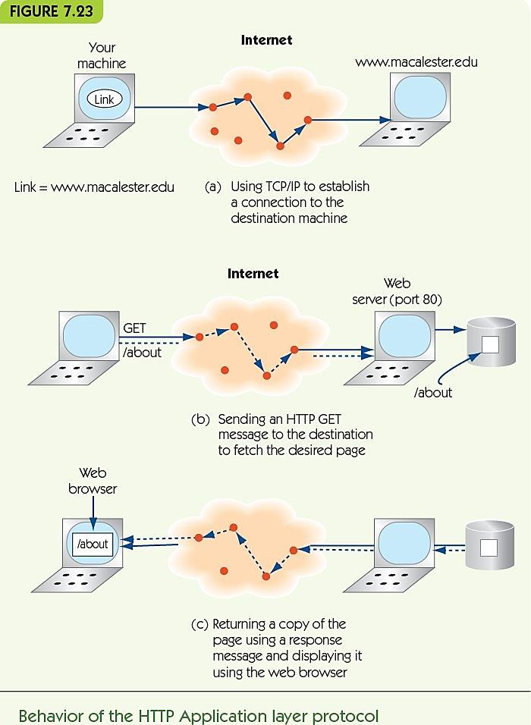
Communication Protocols: Data Link Layer (6 of 6)

Slide 47
Network Services and Benefits Interpersonal Communications
Interpersonal Communications
Electronic mail (email)
A message read at the recipient’s convenience
Fast, multimedia, broadcast medium
Bulletin board system (BBS)
Public forum for shared communications
Evolved into Internet forums, chat rooms
Instant messaging and texting

Slide 48
Network Services and Benefits Social Networking
Evolved out of the bulletin board system
Benefits
Fast communication with people around the globe
The potential for rich discussion around a topic
A public forum where many people can contribute
Pitfalls
Anything posted online can follow you forever
Cyberbullying
Potential invasion of privacy

Slide 49
Network Services and Benefits Resource Sharing (1 of 2)
Print servers serve all computers on a LAN
File servers provide storage to all users
Client/server computing
Some nodes provide services; other nodes use those services
Distributed databases and data warehouses
Massive data stored in various sites online
Groupware or wiki
Support collaborative knowledge/data construction

Slide 50
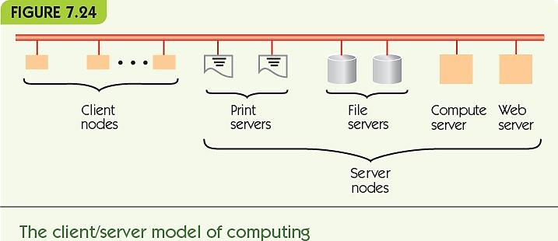
Network Services and Benefits Resource Sharing (2 of 2)

Slide 51
Network Services and Benefits Electronic Commerce
Electronic Commerce (ecommerce)
Early applications
Automatic paycheck deposit
ATMs
Checkout scanners and inventory systems
Current applications
Online stores
Electronic bill payment
Online payment systems (PayPal)
Individual sales to the world (craigslist, eBay, etc.)
8% of all retail sales ($335 billion a year)

Slide 52
Cloud Computing (1 of 2)
Alternative to client/server model
Nodes are local; server is off-site
May be part of an integrated server farm
Greatly reduced costs
Virtualization
Separation of a service from the entity providing it
Many types of cloud services
Infrastructure
Application
Platform and development

Slide 53
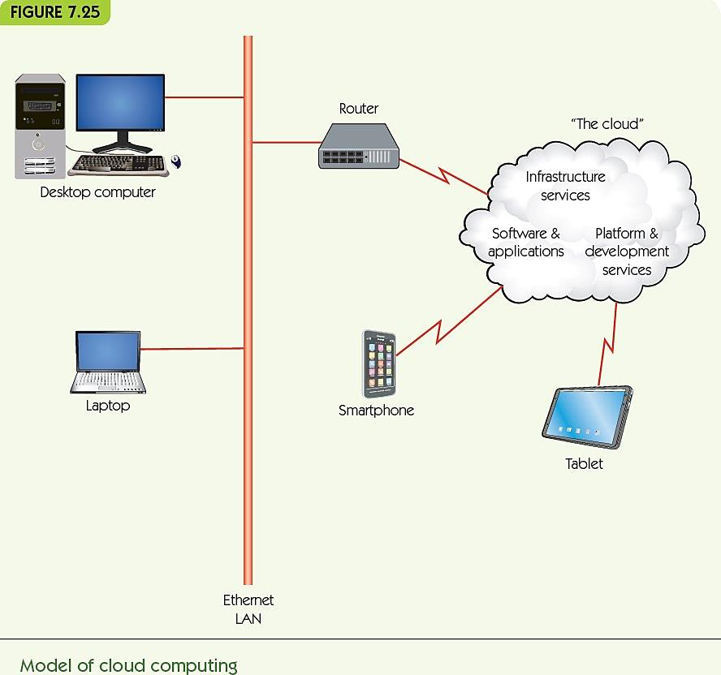
Cloud Computing (2 of 2)

Slide 54
A History of the Internet and the World Wide Web
1997: “A Brief History of the Internet” by some of the founders
Early years
1962: Licklider’s “Galactic Network”
1966: ARPA-funded ARPANET
1972: email
1970s/1980s: many networks (e.g., HEPNet and DECNet)
Internetworking: standards for communication
Gateway: device for translating between networks

Slide 55
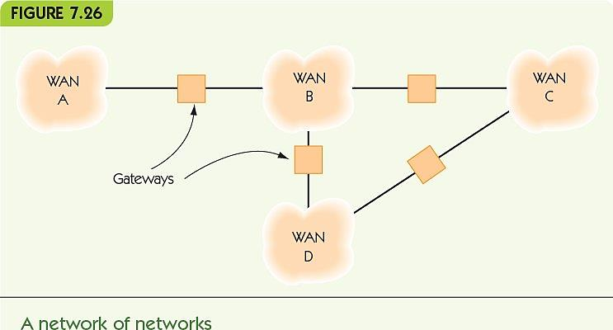
A Brief History of the Internet and the World Wide Web (1 of 5)

Slide 56
A Brief History of the Internet and the World Wide Web (2 of 5)
Middle years
TCP/IP was the established standard
Telnet, FTP (File Transfer Protocol)
NSFNet broadened access (1984)
ARPANET: only open to ARPA grant recipients
NSFNet: open to universities, government agencies, libraries, museums, and schools
Networks began to connect (late 1980s)
ARPANET ceased to be separate network
NSFNet turned over to private providers (1995)

Slide 57
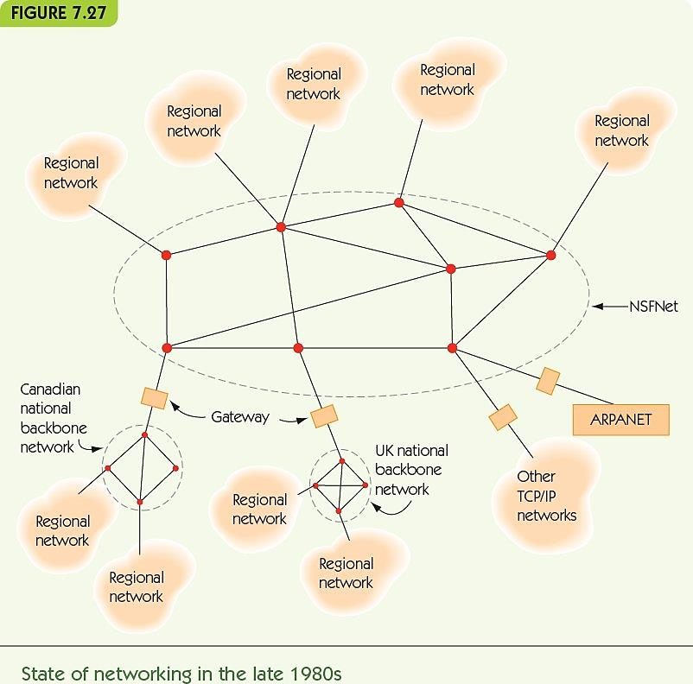
A Brief History of the Internet and the World Wide Web (3 of 5)

Slide 58
A Brief History of the Internet and the World Wide Web (4 of 5)
The World Wide Web
High-energy physicist at CERN, Tim Berners-Lee wanted user-friendly information and data exchange
Hypertext: documents containing links to other documents became the foundation for modern-day webpages
Web protocols were made public; led to rapid expansion

Slide 59
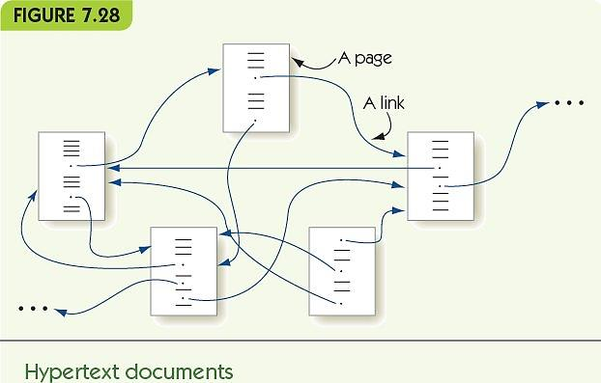
A Brief History of the Internet and the World Wide Web (5 of 5)

Slide 60
Summary (1 of 2)
Computing devices can communicate through various wired and wireless media.
Computer networks vary in size and form, including LANs, WANs, WLANs, and WWANs.
LANs are configured differently from WANs and use different communication methods.
The Internet is a WAN of WANs.
Protocols are necessary to standardize communications across different media and among different computers.
Social networking grew out of BBS communities.

Slide 61
Summary (2 of 2)
The protocol hierarchy breaks down network communications into different layers of abstraction.
Protocols like the ARQ algorithm and TCP/IP provide rules for the transfer of information.
The Internet has permitted new kinds of connections among people: email, ecommerce, and resource sharing.
Cloud computing is replacing client/server.
The Internet and web grew from ARPANET and NSFNet as new network applications developed.

